Slide 1


Valuing Innovation & Entrepreneurship (I&E) Impact for Faculty
“Translational research activities at ART awardee institutions should be treated on par with fundamental research activities in faculty recruitment, tenure, and promotion decisions."
From National Science Foundation’s (NSFs) Advancing Research Translation (ART) 2023 solicitation.
Rich G. Carter, Ph.D.
Faculty Lead for Innovation Excellence and Professor of Chemistry
Oregon State University
Website: https://ptie.org

Slide 2


What is the Promotion & Tenure Innovation & Entrepreneurship (PTIE) effort all about?
Created though a grant from the NSF (CNS-1936073), Follow-on funding (TIP-2430589)
Focuses on the inclusive recognition of I&E impact by faculty.
Coalition-based approach involving over 65 universities.
  Identify best practices, suggested language, metrics and process reform for evaluation of faculty promotion cases containing I&E impact.
  Support concurrent efforts for reform in other areas of promotion & advancement and address bias within the process.
  Created detailed set of PTIE recommendations collaboratively.
https://ptie.org

Slide 3
Intent of this Effort
 | What it is not |  | Intent
❌ | This effort does not seek to make I&E a required component for faculty or dilute (or raise) the requirements for advancement. | ✅ | The intent is to broaden the bar of promotion and tenure to be more inclusive of faculty not fully valued under the current paradigm.
❌ | This effort does not seek to reduce or remove the importance of basic research in any way. | ✅ | The intent is to provide equal representation for other areas of scholarship not currently valued fully in the current paradigm.
❌ | This effort is not seeking to make faculty into business people. | ✅ | The intent is to support faculty who have desire to seek impacts beyond the publication/grant paradigm.
❌ | This effort is not supportive of justifying a focus on I&E as a money-making mechanism. | ✅ | This intent is to be an essential component of realizing the institution’s mission to society.
https://ptie.org

Slide 4
Promotion & Tenure (P&T) is the Fulcrum
Hiring Process
Position Description
Allocation of Resources ($$, time, space, people)
Annual Evals
Recognition & Awards
P&T
https://ptie.org

Slide 5



Language Matters
Societal impact / public impact
Innovation
Inclusive
https://ptie.org

Slide 6
Aligning Values
Acquiring Knowledge
Academy
Career Preparation & Resiliency
Prestige & Recognition
Economic Impact
Societal Impact
University
Public
Return on Investment (ROI)

Slide 7
Breadth of I&E Impact
I&E-impact can occur in all areas – not just research
PTIE recommendations focus in valuing I&E within each all three areas
PTIE embraces a broad interpretation of I&E to ensure that the effort is inclusive across the institution and academic disciplines, including the arts and humanities.
Research
Teaching
Service
https://ptie.org

Slide 8

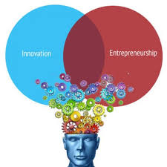
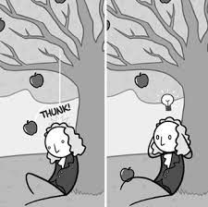

Supporting the Pursuit of Knowledge
Pursuit of knowledge is a core value of universities.
I&E-informed research should be valued the same as other areas.
This freedom enables discovery.
Current paradigm for I&E retards (not protects) the pursuit of knowledge.
https://ptie.org

Slide 9
Publications on PTIE Work
PTIE Recommendations: “Expanding Promotion and Tenure Guidelines to Inclusively Recognize Innovation and Entrepreneurial Impact.” (https://ir.library.oregonstate.edu/concern/defaults/jw827k251)
Carter, R. G.; Mundorff, K.; Risien, J.; Bouwma-Gearhart, J.; Bratsch-Prince, D.; Brown, S. A., Campbell, A. L.; Hartman, J. C.; Hasemann, C. A.; Hollenbeck, P. J.; Lupiani, B.; McCarty, O. J. T.; McClure, I. D.; Mealey, K.; Mimura, C.; Romero, A. J.; Sztajn, P.; Van Egeren, L. "Innovation, entrepreneurship, promotion, and tenure." Science 2021, 373, 1312-1314 (DOI: 10.1126/science.abj2098).
Bouwma-Gearhart, J.; Lenhart, C.; Carter, R.; Mundorff, K.; Cho, H.; Knoch, J. Inclusively Recognizing Faculty Innovation and Entrepreneurship Impact within Promotion and Tenure Considerations. J. Open Innov. Technol. Mark. Complex. 2021, 7, 182 (DOI: 10.3390/joitmc7030182)
Bouwma-Gearhart, J.; Carter, R. Mundorff, K. "A Call For Promoting Faculty Innovation and Entrepreneurship." Change 2021, 53 (2), 18-24 (DOI: 10.1080/00091383.2021.1883973)
Significant additional content is available on the ptie.org website

Slide 10



1. University-Wide Language
Institution-specific language that cites the mission statement and/or stated university priority
Connect faculty member contributions to broader societal impacts
Link those priorities to the evaluation process
https://ptie.org

Slide 11
2. I&E Metrics in Teaching, Research & Service
Intellectual Property
Entity Creation
Sponsored Research
Collection of metrics should be used as indicator data for narrative thesis of impact
I&E Career Preparation
Use & Licensing
I&E Engagement
https://ptie.org

Slide 12
3. I&E Text for Evaluation Criterion
Research
I&E-impact can occur in all areas – not just research
PTIE recommended providing category-specific language and structure that can be utilized as appropriate within P&T guidelines
Teaching
Service
https://ptie.org

Slide 13



4. Process Reforms
PTIE
Changing P&T guidelines alone will not change university culture
Also address P&T practices
Align with other efforts to advance change in promotion & advancement
https://ptie.org

Slide 14
Core Recommendations
URL: https://ptie.org/ptie-recommendations/
University-Wide Language directly linking the evaluation of faculty to institutional mission, values & goals in the university P&T guidelines and additional levels at the institution (e.g., college, school, department).
I&E Metrics to serve as indicator data to be used in a narrative thesis of impact. Metrics are grouped into six sub-categories: (a) intellectual property, (b) sponsored research, (c) use & licensing, (d) entity creation, (e) I&E career preparation and (f) I&E engagement.
I&E Text for Evaluation Criterion to be incorporated into the (a) research (scholarship & creative activity), (b) teaching & advising and (c) service categories found in university P&T guidelines.
Process Changes for supporting systemic culture change, improving transparency and addressing bias (e.g., directions for personal statement, external reviewer resource and guidance, involvement of P&T process consultants, expanded training, reframing & importance of DEI).
These core elements are also intended to provide a framework for concurrent efforts to reimagine other areas of scholarship in promotion and advancement.
https://ptie.org

Slide 15

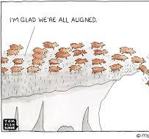

Early Steps to Support Culture Change
Innovation Advocates
Determine Administrative Alignment
Campus Survey for Faculty Need (PTIE can provide)
Faculty I&E Video Sent with Survey: https://oregonstate.box.com/s/jd0zo610p94tn8g5d37te3r94pgkt57k

Slide 16



Early Steps to Support Culture Change
Identify a faculty champion(s)
Engage Faculty Senate early
GAP Analysis of campus programs to support I&E
https://ptie.org

Slide 17
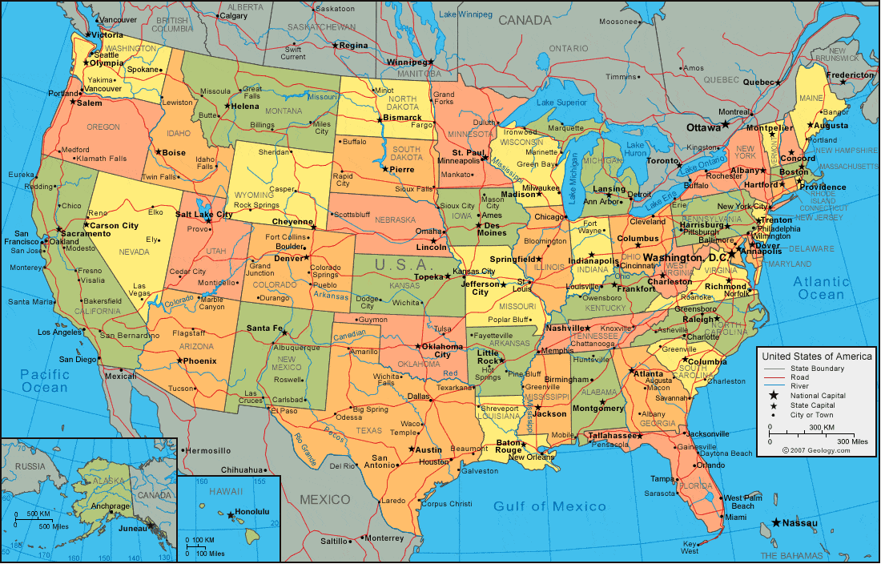


















What’s Next for PTIE
2024 NSF Award (TIP-2430589) working with First Accelerating Research Translation (ART) Cohort
National Effort Supporting I&E Across the Country
https://ptie.org

Slide 18




Resources Available
Site Visits
Case Studies
Training on PTIE
PTIE
Pilot Programs on Process Reform
Aligning with other reforms
https://ptie.org

Slide 19
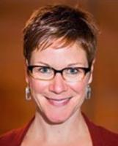
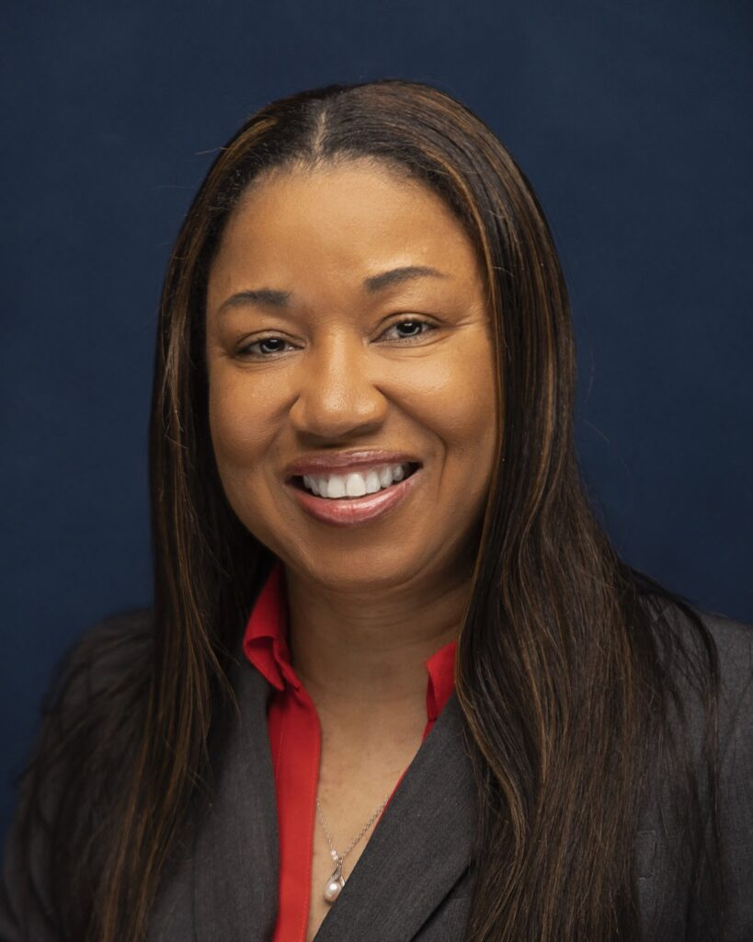
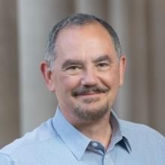
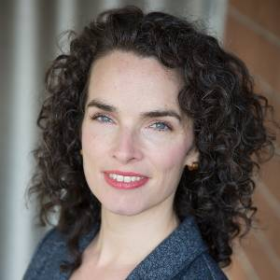
Questions?
Jana Bouwma-Gearhart
Associate Dean & Prof. of Ed.
Oregon State University
Almesha Campbell
AVP for Research & Econ. Dev.
Jackson State University
Rich G. Carter
rich.carter@oregonstate.edu
Susanna Campbell
Provost Assoc. Prof. of Foreign Policy & Global Security
American University
Karl Mundorff
Executive Director for I&E
Oregon State University
https://ptie.org

Slide 21


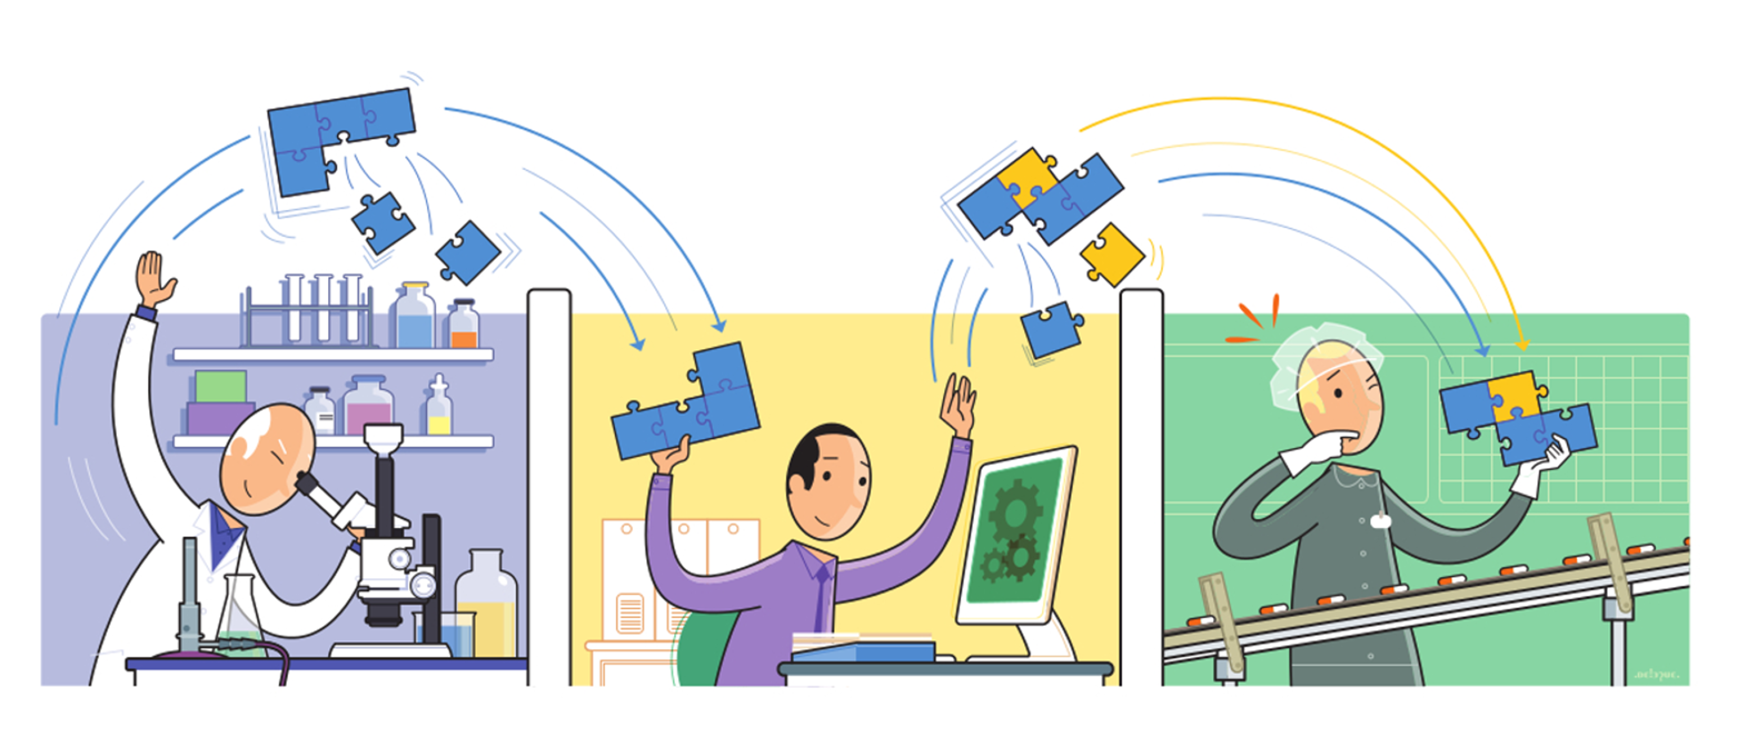






Perspective Matters
Government Official
Student
Researcher
Tech Transfer Manager
Industry Partner
University Administrator
Regulator
Faculty Member
General Public
Lawyer
Entrepreneur / Investor

